Slide 1
Delivering Services

Slide 2
Overview
The challenge of services branding
Defining the levels of service
Evaluating service quality: RATER
Service recovery
The Gap Model of Service Quality
The role of internal service

Slide 3
Service Branding Challenges
Managing a service brand is more challenging than managing a branded product
  Intangibility
  Inconsistency
  Inseparability

Slide 4
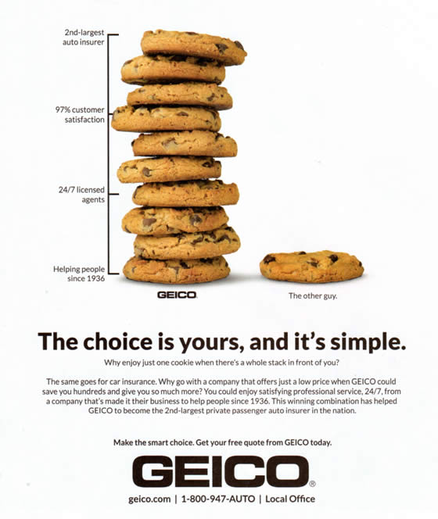
Tangibilize the intangible…

Slide 5
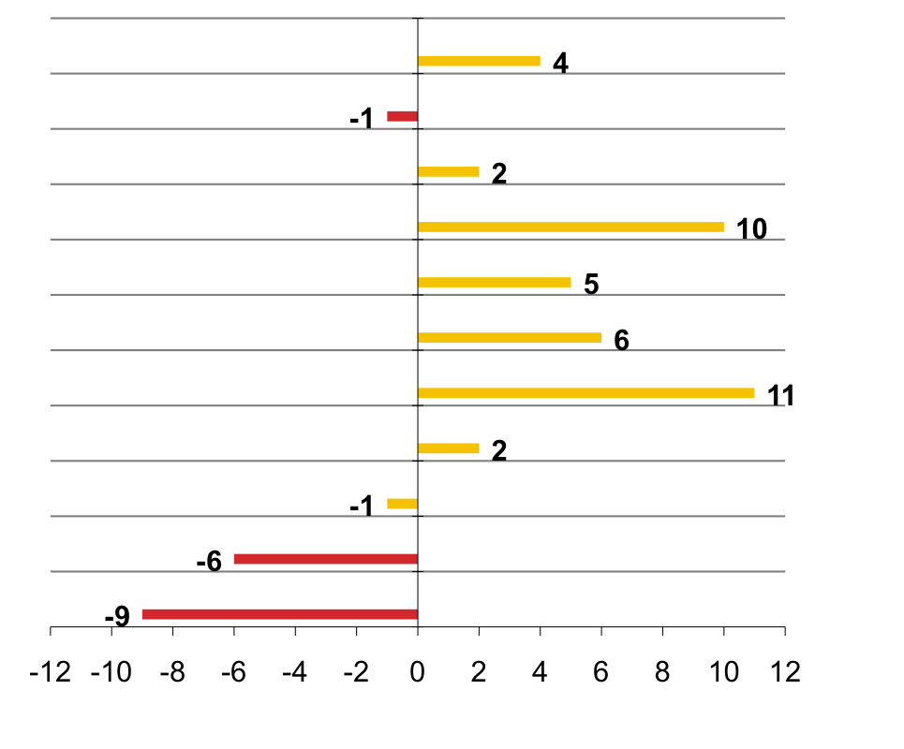
Assessing Retailer Service Quality
Difference in Percent “Top Box” XYZ Minus Top Competitor
Overall Customer Service
Clean Rest Rooms
Convenient Fitting Rooms
Friendly Associates
Knowledgeable Associates
Available Associates
Hassle-Free Returns
Advertised Merchandise in Stock
Attractive Displays
Selection
Fashion

Slide 6
Defining Service
Core Service:
  “The right product, at the right place, at the right price, at the right time”
Expected Service:
  Customer expectations regarding dependability, courtesy, etc.
Augmented Service:
  J.C. Penney: “...it is the service the customer doesn’t expect that endears...”
Potential Service:
  Whatever! - e.g. “Just looking” buttons

Slide 7
Start With The “Bull’s Eye” And Work Out!
EXPECTED Service
CORE Service
POTENTIAL Service
AUGMENTED Service

Slide 8
R. A. T. E. R.
The Five Dimensions of Service Quality:
  Reliability
  Assurance
  Tangibles
  Empathy
  Responsiveness

Slide 9
Service Recovery
    “Do things right the first time; do them very right the second time.”
Rule No. 1:
Do everything within reason to satisfy your customer.
Rule No. 2:
There are no other rules.

Slide 10
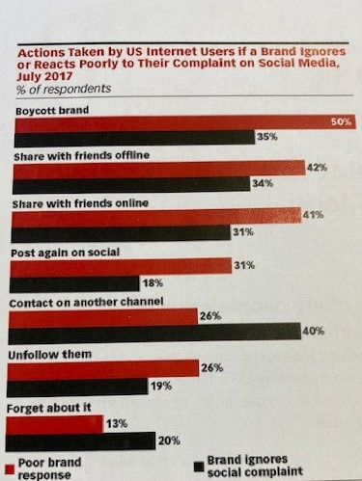
Actions Take by US Internet Users if a Brand Ignores or Reacts Poorly to Their Complaint on Social Media

Slide 11
The "Gap Model" of Service Quality
Customer Expectations
QUALITY GAP
Customer Perceptions

Slide 12
Reduce Customer Service Gaps through “Internal Service”
EMPLOYEE
RETENTION
REVENUE
GROWTH
INTERNAL
SERVICE
QUALITY
EMPLOYEE
SATISFACTION
EXTERNAL
SERVICE
VALUE
CUSTOMER
SATISFACTION
CUSTOMER
LOYALTY
EMPLOYEE
PRODUCTIVITY
PROFITABILITY
OPERATING STRATEGY AND SERVICE
DELIVERY SYSTEM

Slide 13
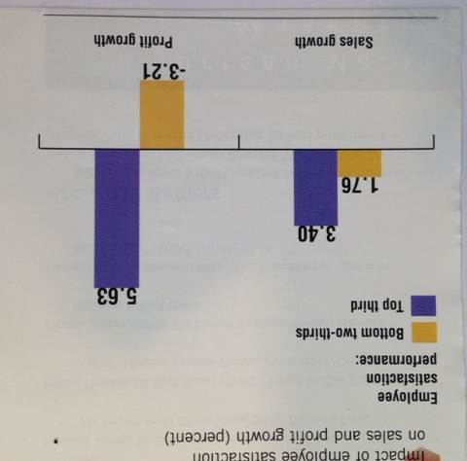
Impact of Internal Service

Slide 14
Improving Service Quality
Understand your customers through market research or face-to-face contact
Treat your employees the way you expect them to treat your customers
Don’t promise more than you can deliver!

Slide 15
Conclusion
How important is the delivery of service to your organization?
Can you identify aspects of your offering that correspond to the four levels of service?
How does your firm’s service stack up on RATER?

Slide 16
End of Lecture

